Slide 1
Planet images
April 12, 2019

Slide 2
Planet imagery

Slide 3
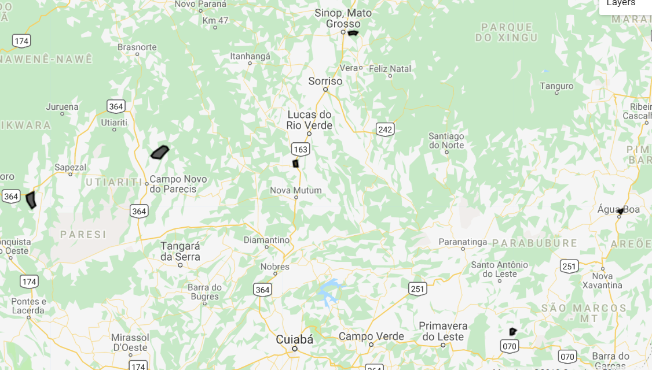
New MT location to download Planet
The locations of these polys are based on on soy_pts_agsat1, so only download for 2016-2017. Try to go for about 30 to 40 fields in different locations instead of 80 fields in a single location because of potential bias due to cloudy days
In MT, look at a place with SC (based on agsat training) and download for a place with known SC – useful for seeing accuracy of classifying SC
Download all of these in for 2016- 2017
Order of priority: poly 11 (has SC), poly 12, poly 14, poly 13, poly 15
Poly 12
Poly 5
Poly 15
Poly 13
Poly 14
Poly 11 (has SC)
Poly11 was ordered and downloaded on April 4.

Slide 4
Timing algorithm

Slide 5
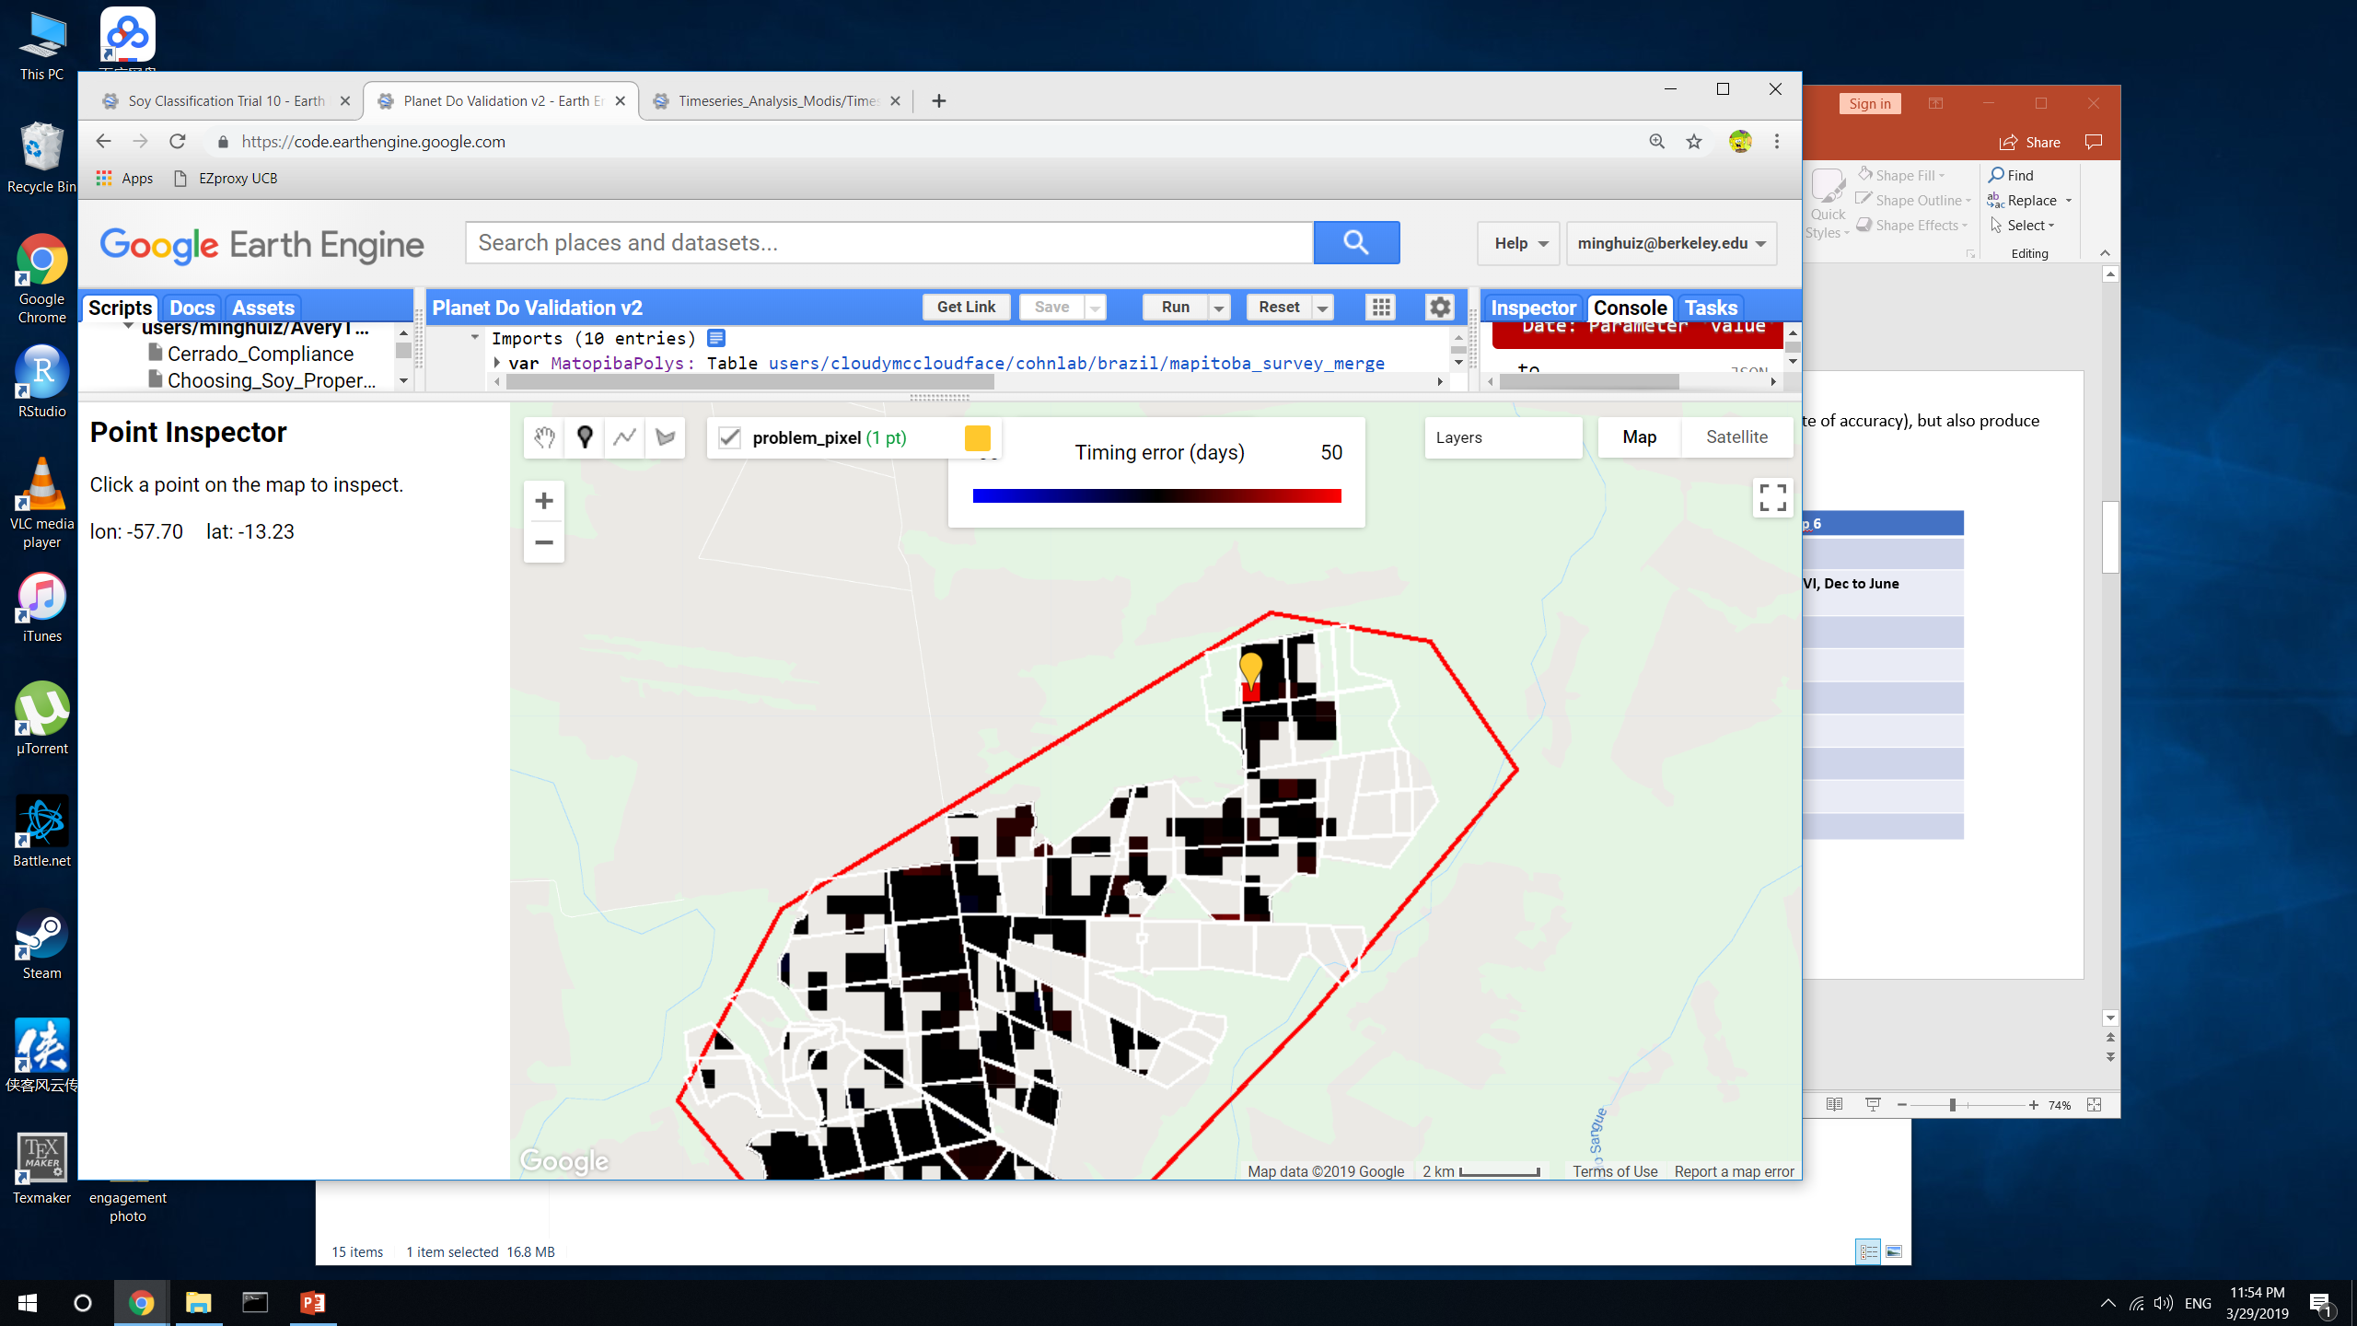
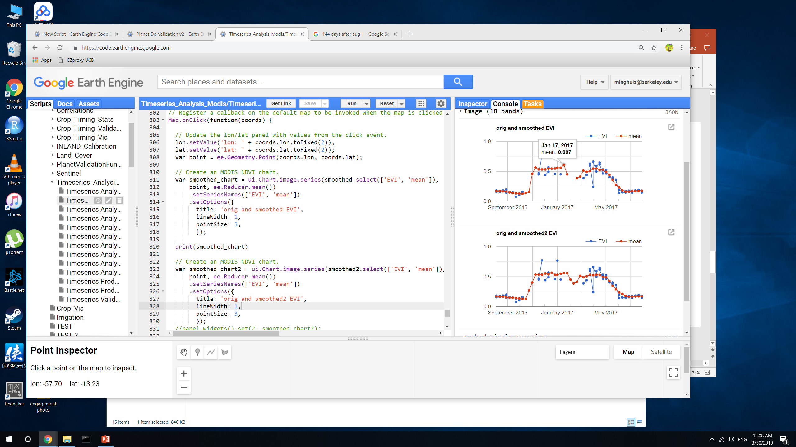
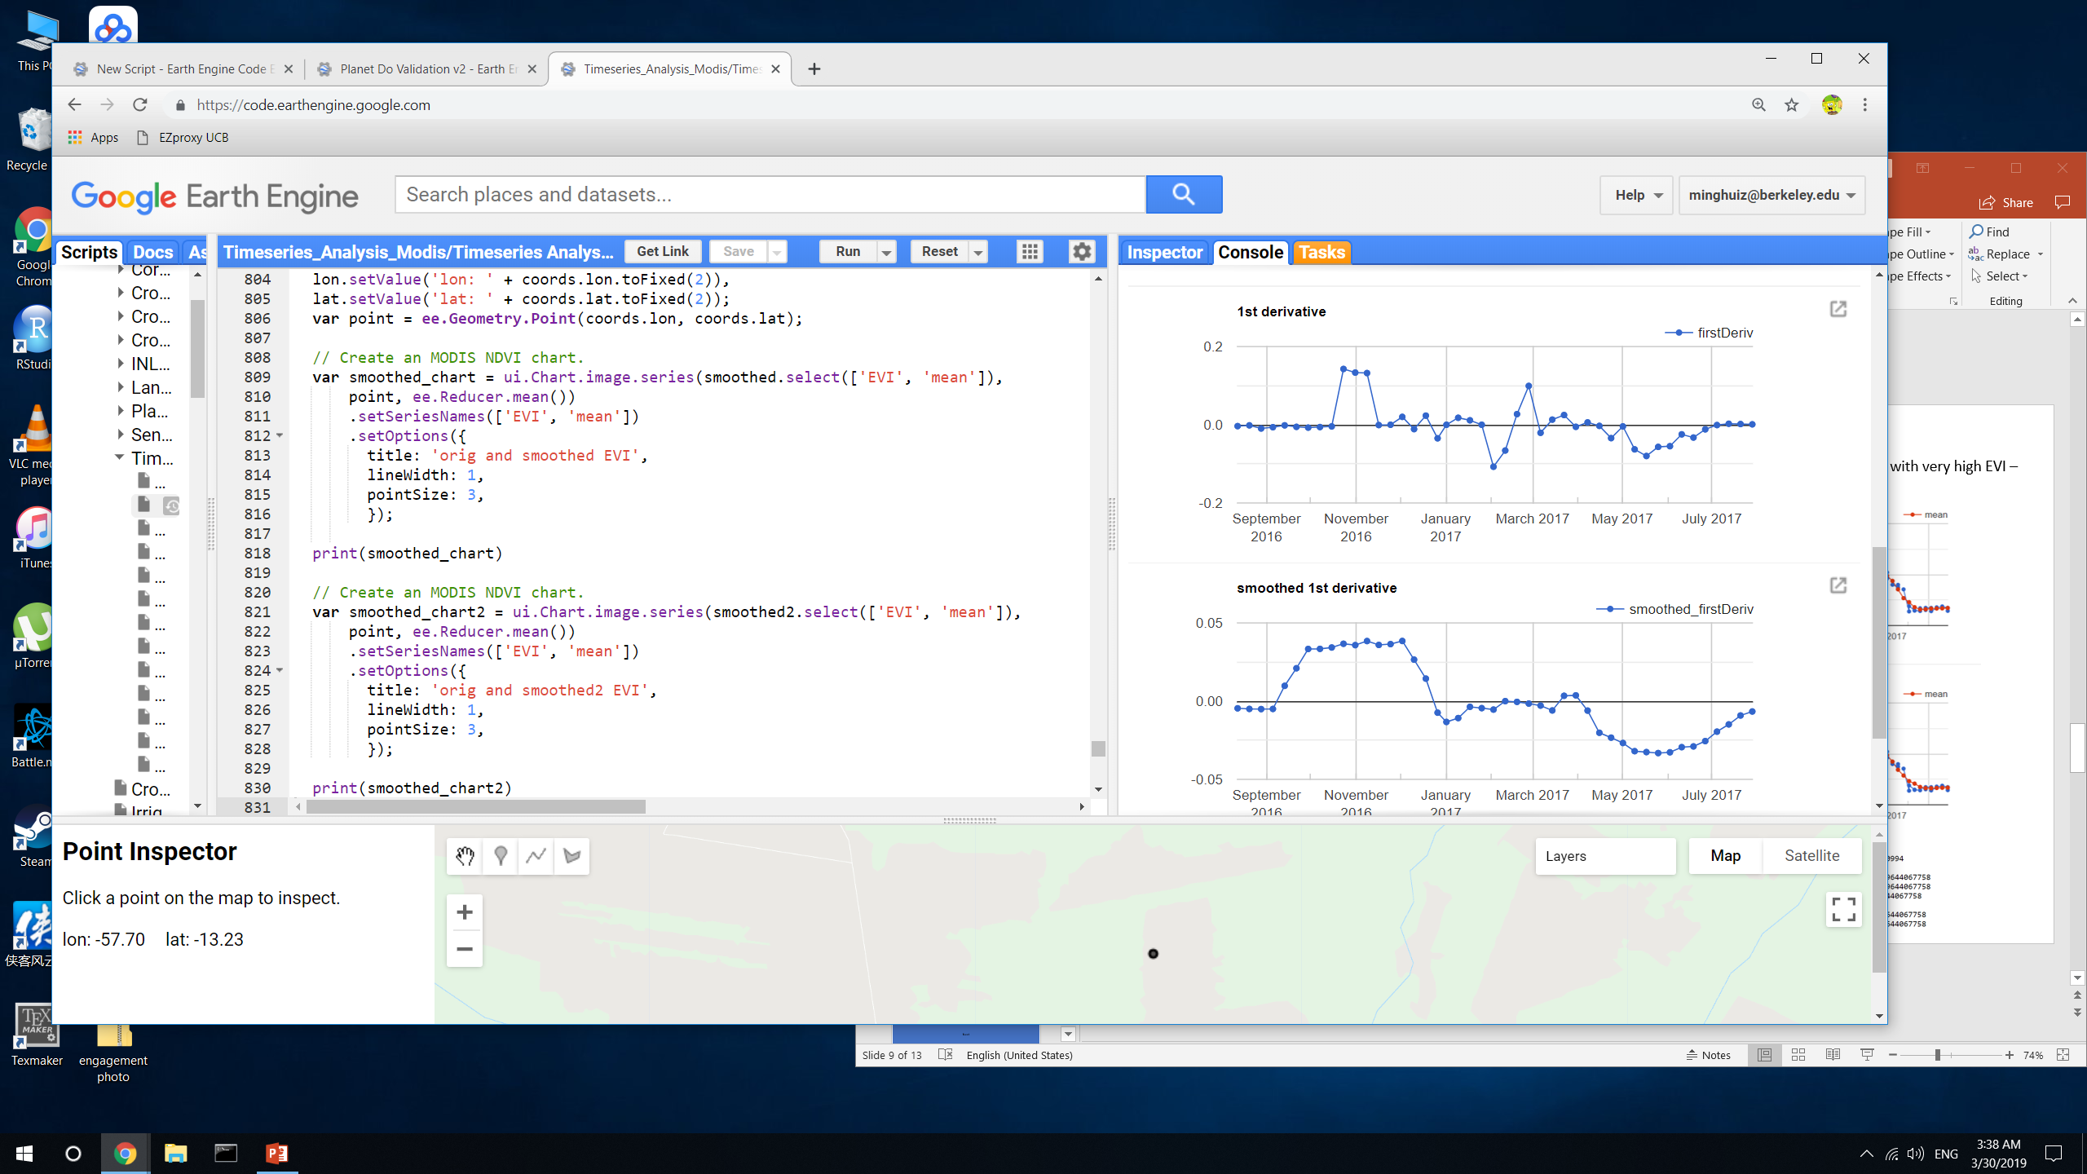
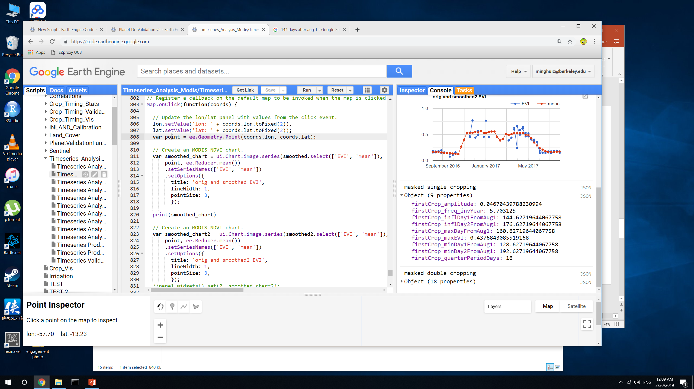
Algorithm check on the pixel in poly5, harvest year 2017 when the estimated plant1 was almost 3 months later
If we mask so that the lowest allowable quarter period is 20, this error wouldn’t be seen in final map.
The algorithm doesn’t work well when the timeseries looks essentially like a step function and there are random days with very high EVI – the location of the maximum is unstable because it’s really flat
The reason that the peak is at a strange location: maybe the qualityMosaic() function doesn’t distinguish well among similar EVIs
The reason that the inflection point is so late: the first derivative was so smoothed that the ‘maximum’ happened much later than it actually did
Estimated:
Peak day = Jan 8
Infl1 day = Dec 23
Quarter period = 16

Slide 6
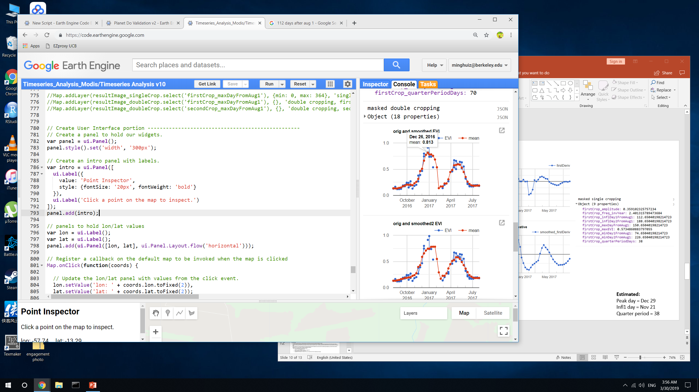
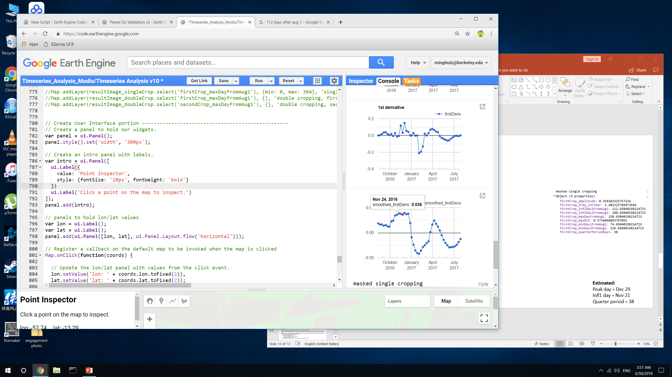
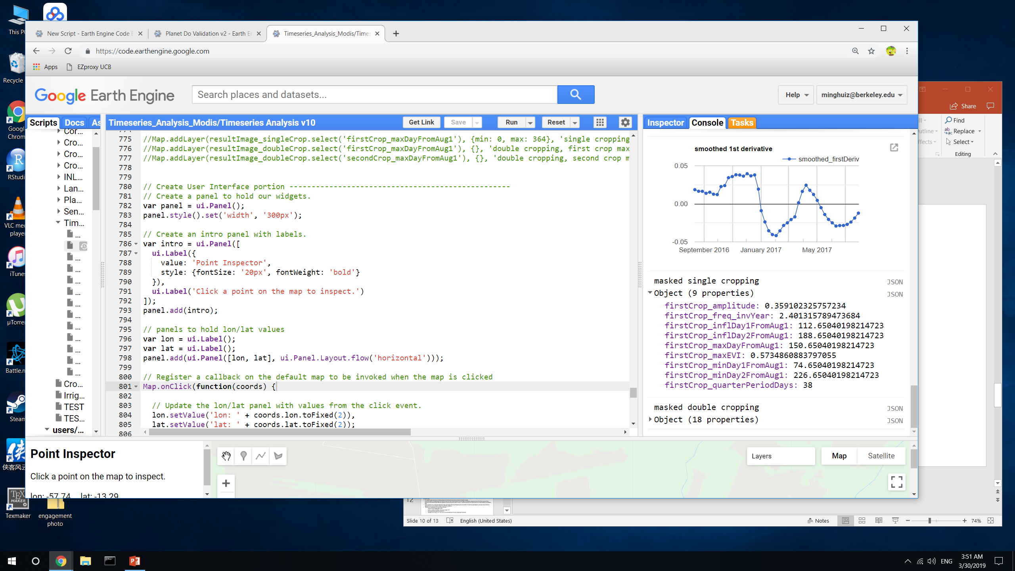
Example of a good pixel
Estimated:
Peak day = Dec 29
Infl1 day = Nov 21
Quarter period = 38

Slide 7
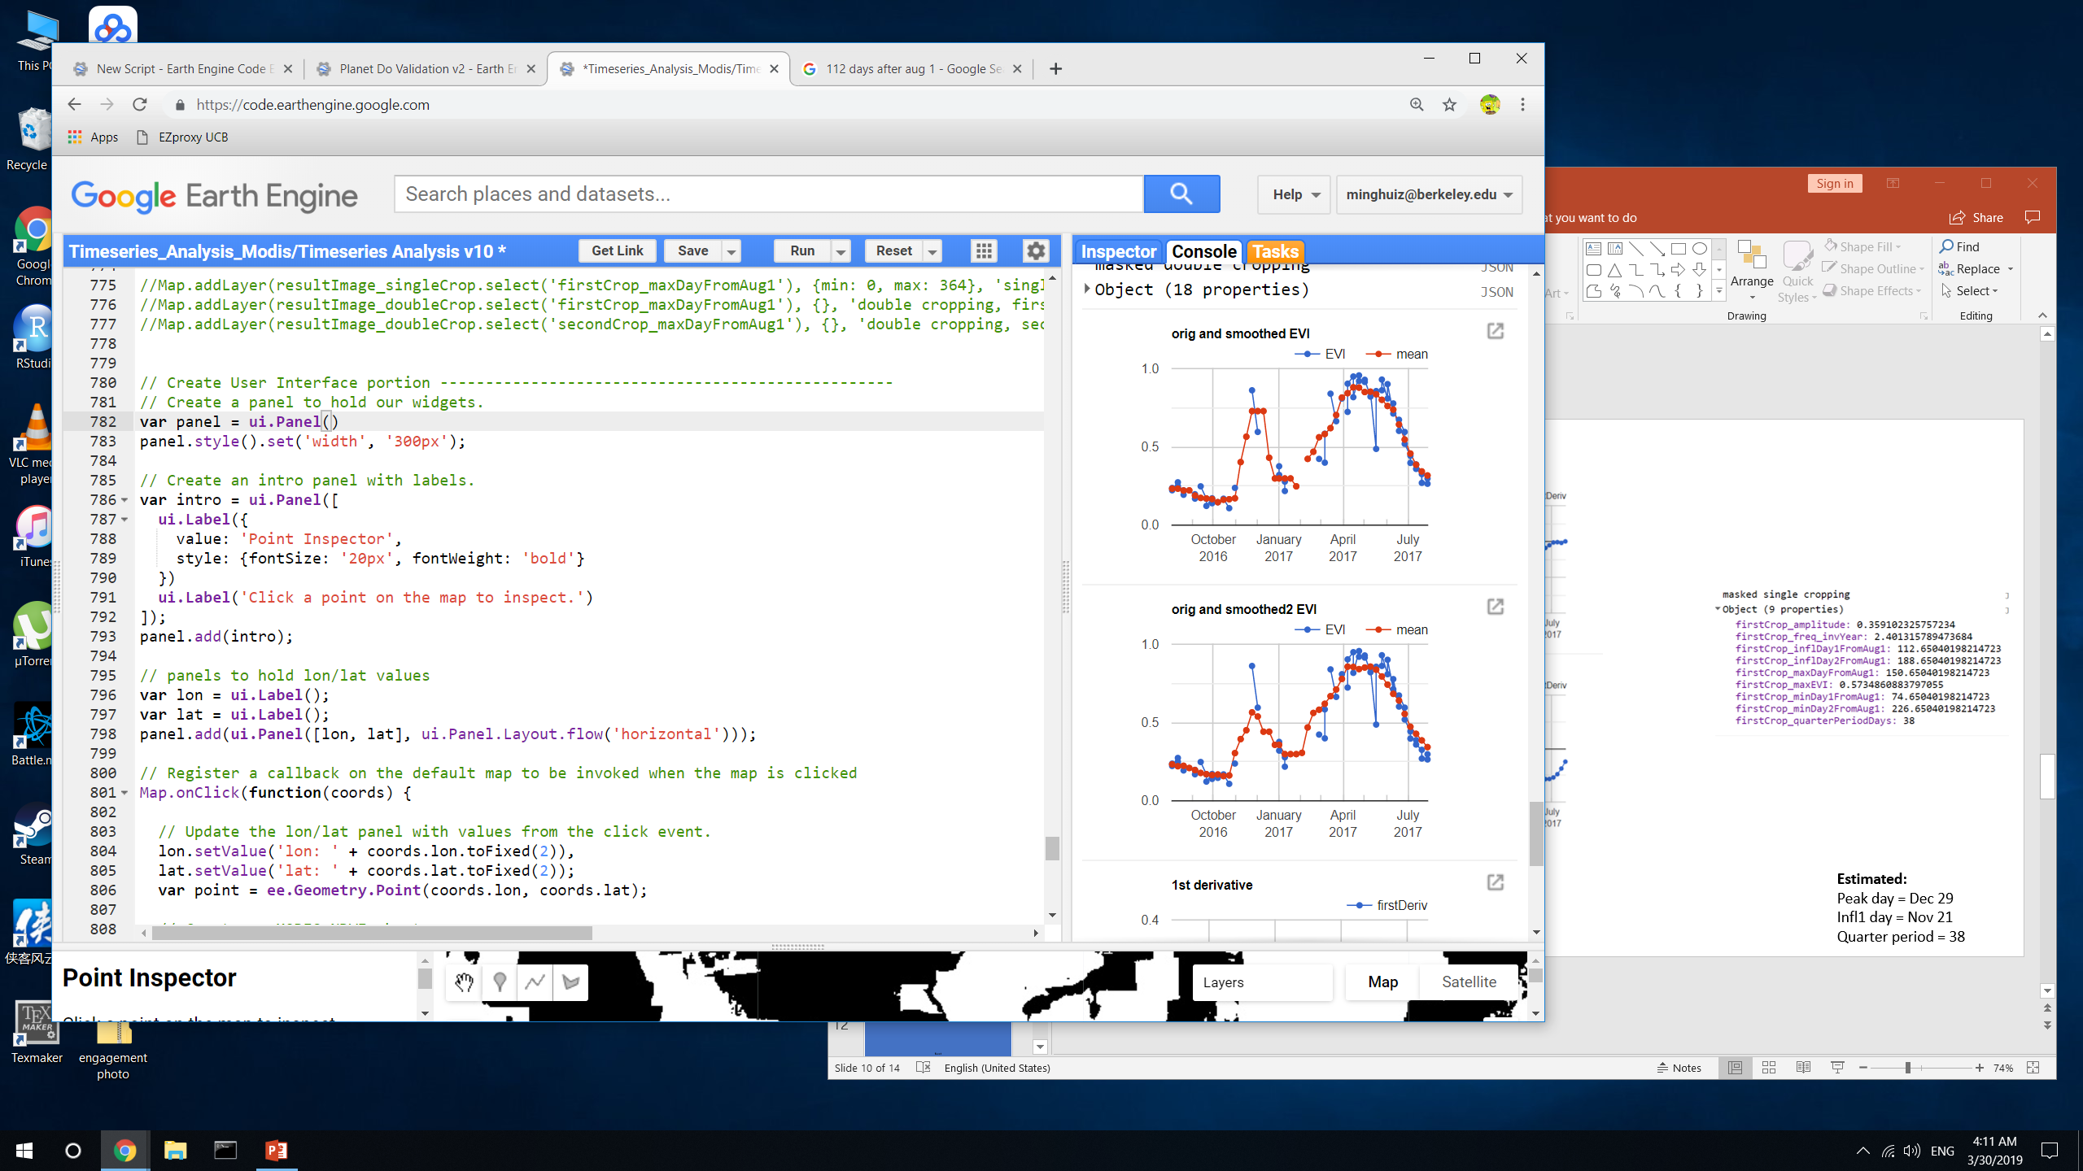
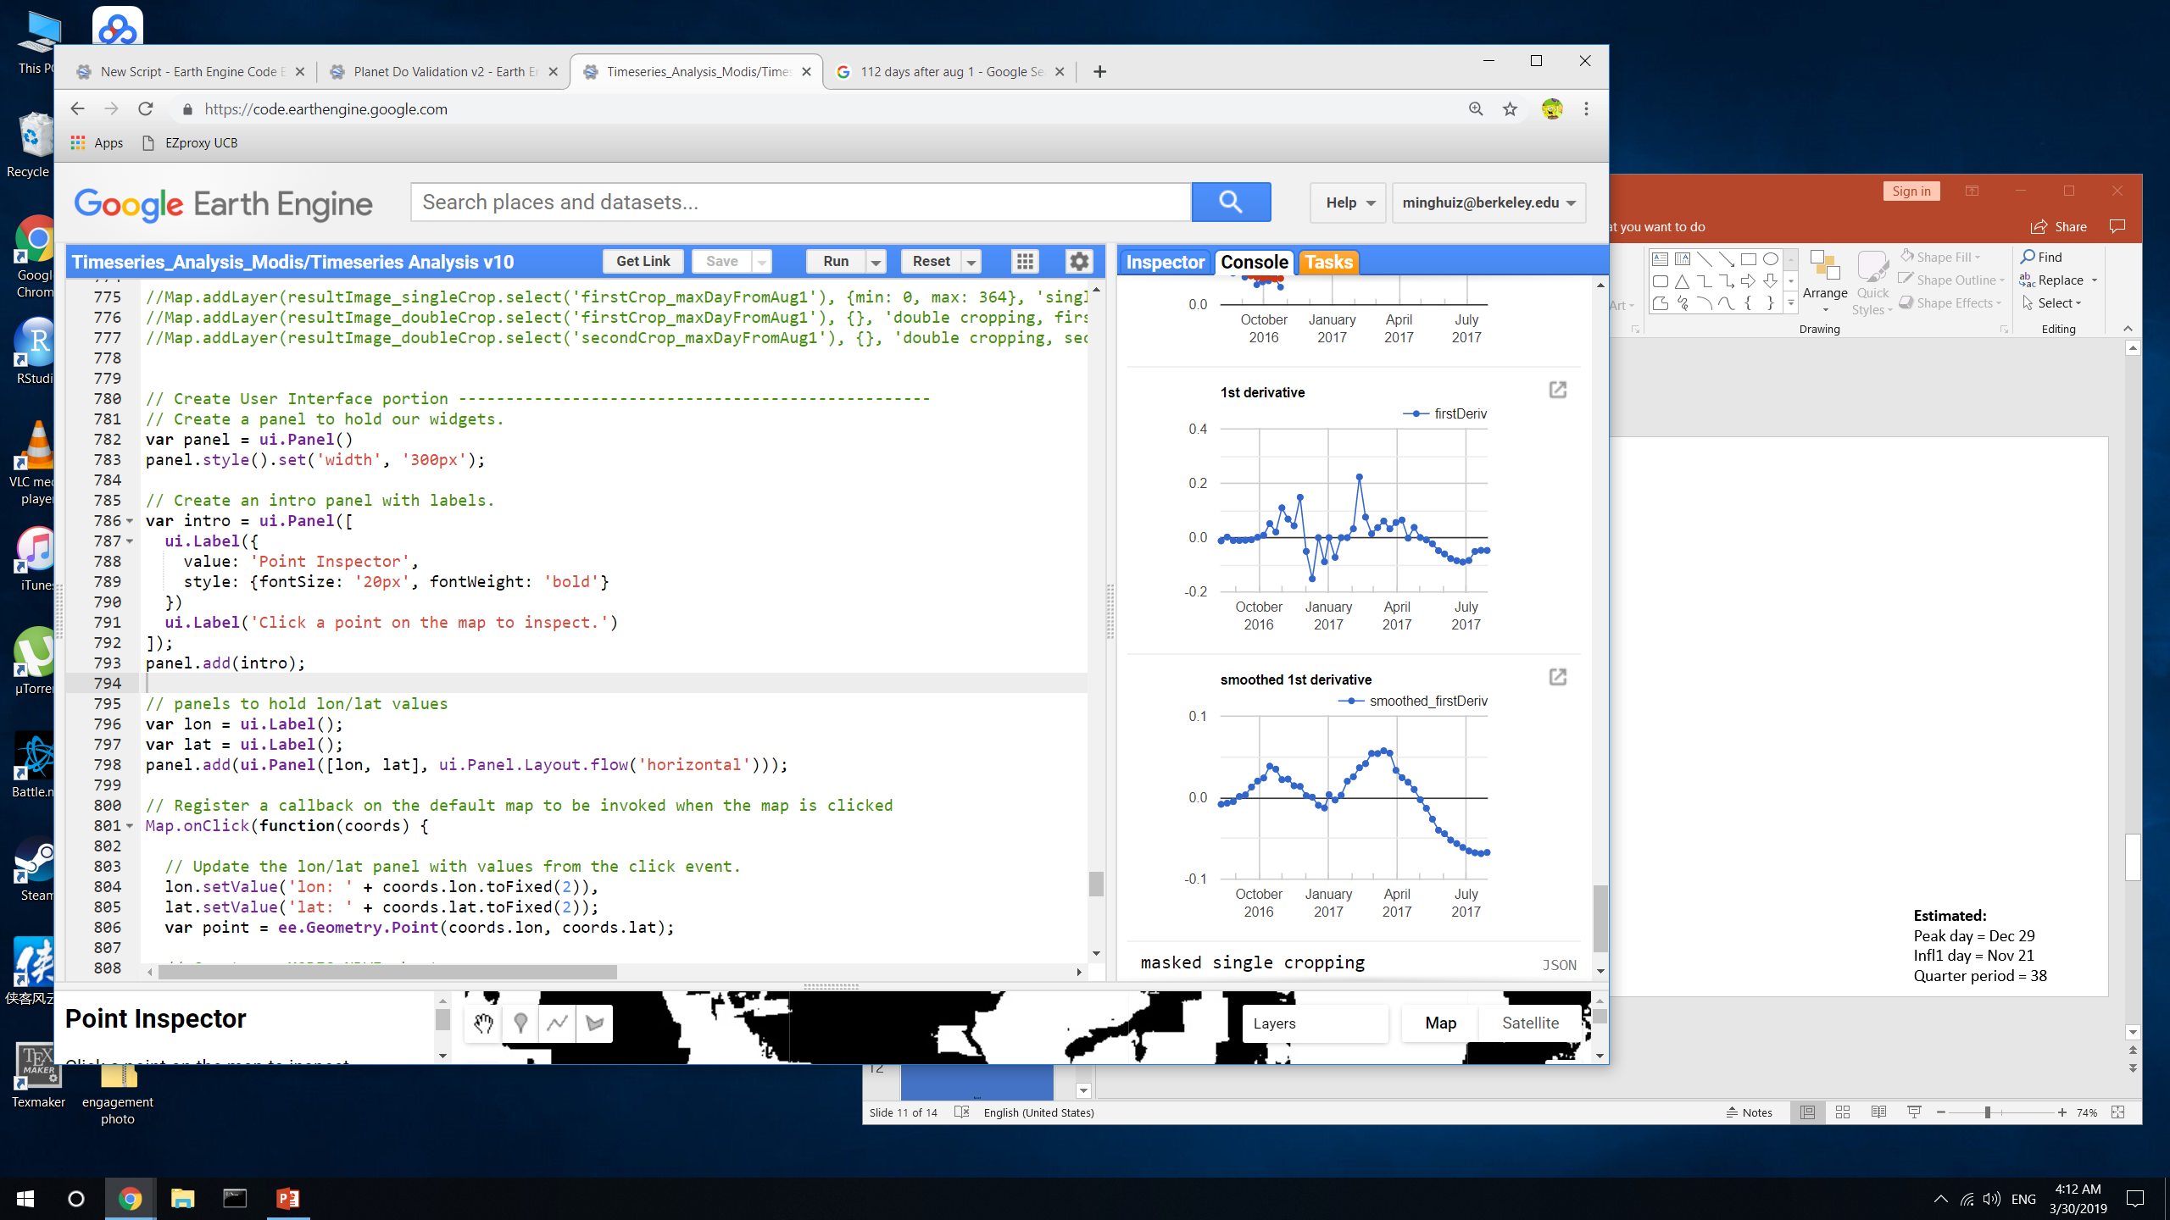
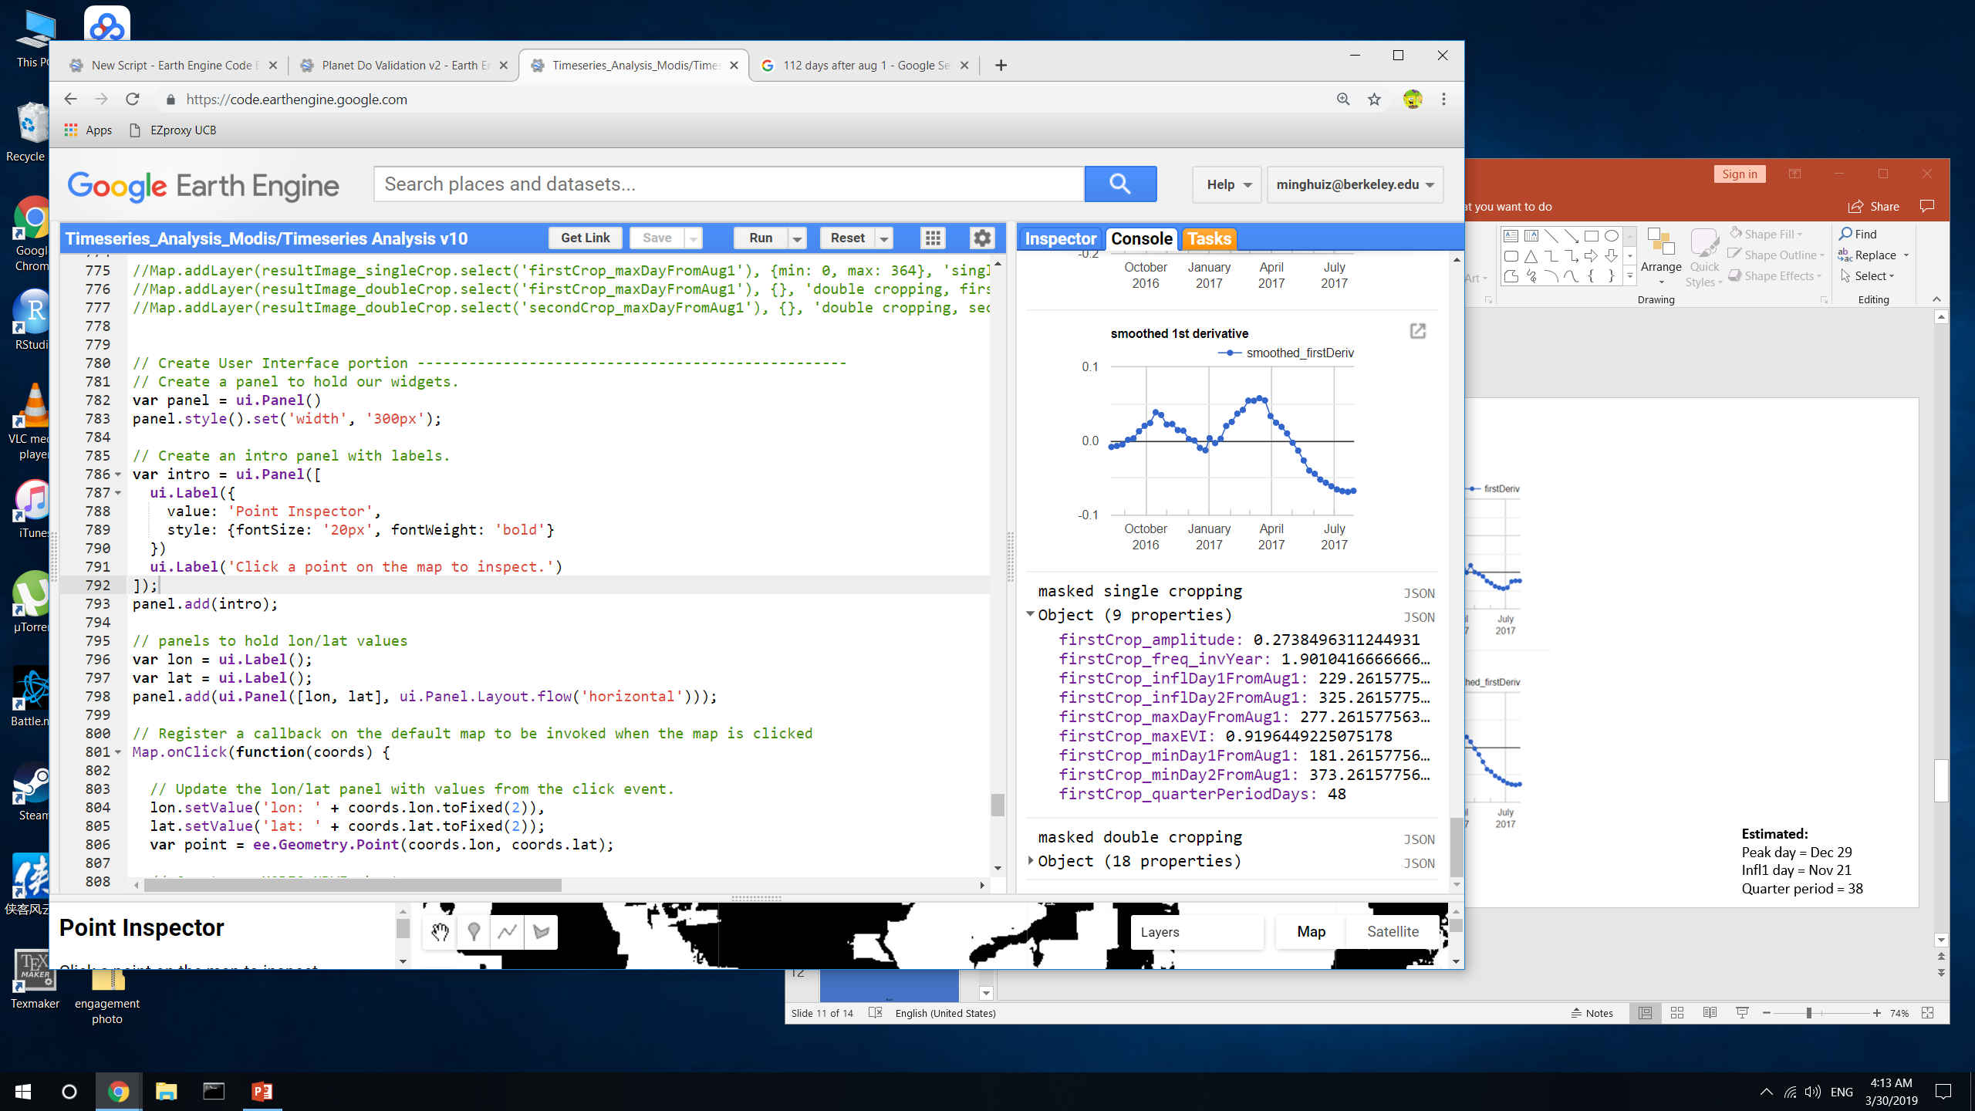
Estimated:
Peak day = May 4
Infl1 day = March 17
Quarter period = 48
Takeaway:
Smoothing the first derivative is necessary because otherwise the inflection point will be very unstable, but smoothing it over 40 day window might shift the peak of the first derivative. The direction of this shift isn’t predictable because it depends on slight variations in first derivative before and after (which itself is very unstable)
This isn’t an issue the majority of the time; try to decrease smoothing window? [before changing the method, look at more Planet image validation data)

Slide 8
Next

Slide 9
Crop timing
For natural vs agri accuracy, try masking edges and masking by crop cycle and peak EVI target only agri
Look at the dates corresponding to the low error fields and see if they represent the full range of crop dates represented by all the fields, because there might be a bias towards fields that were planted at a time when there weren’t clouds. This bias would also be solved if there are many locations of validation data.
Check QA/QC for the small peak before the larger peak (base threshold off places we know are DC and what the peak height is),
Robustness checking of timeseries analysis: how would plant, harvest results be different if (1) smooth EVI timeseries more or less; (2) smooth the 1st derivative more or less; (3) pick another cutoff date for first vs second peak? Choose the best combo based on Planet validation data; if no clear winner, report all versions.
Attach error distributions to crop timing estimates
At pixel and field/aggregated scale
Based on width of validation range and ‘range error’
Do all pixels/cells have the same error?
Separate errors for p1, (h1 + p2), and h2 (due to likelihood of clouds impacting TS analysis)
NEXT Planet image downloads:
For poly6 to 8 (based on soy_pts_agsat1), only download for 2016-2017. these are in MT – try to go for about 30 to 40 fields in different locations instead of 80 fields in a single location because of potential bias due to cloudy days
In MT, look at a place with SC (based on agsat training) and download for a place with known SC – useful for seeing accuracy of classifying SC
Monitor BearBuy for Planet purchase
Colab: best way to use Python API with GEE (ipython notebook server)
Do pip install earthengine-api in colab to get virtual machine
Import ee
ee.Initialize()
ee.batch.Task.list() – proves can use earth engine
Docs: github/earthengine-api -> python -> examples -> ipynb -> example stuff

Slide 10
Planet imagery workflow
Uploading planet images as GEE asset
Properties of each image in PlanetLabs folder
Year, Month, Day, Satellite
PS_analytic_4band
RE_ortho_analytic
PS_ortho_analytic
PS_scene_analytic
Asset name is same as the description used in downloading from Planet web site
Lookup table in desktop has Planet order number and description and GEE asset name
Step | To do | Script/web site
1 | Find locations, years where Planet images are needed. Keep info on shp name, image name(s), and dates downloaded in Image_Lookup file in Google Drive | GEE: LandCover/Planet Image Selection
2 | Download cloud free, high temporal resolution Planet images (may need to pare down on locations, years) | Planet web site. Keep downloaded images in desktop
3 | Upload images as GEE assets | In desktop, keep tabs on asset id, polygon name, etc.
4 | Delineate individual fields, natural veg, agri, urban (houses) and center pivot in Planet imagery, and export as asset into the folder Planet Validation Data. The difference between fields and agri is that the fields contain individual (usu square) fields for timing observation purposes, whereas the agri contains lumped agri for land classification (natural vs agri) purposes. Assets are exported as ‘raw_agri_fc_poly1_year’, etc. need to turn delineated geometries into feature collections in order to export. | GEE: LandCover/Planet manual Field Delineation or Planet OBIA
5 | First import the Planet images and make custom visualizations for each, and map each with its own custom vis. Step through fields in CAR poly and record observed crop timing, export observations as feature collection to asset. Assets are exported as ‘timing_obs_for_polyName_in_year_part#’. Make sure to change the ‘part#’ BEFORE entering obs! 0 for SC, 1 for DC, 3 for TC or DC + failed first crop (2 is other agri in Jake’s classification) | GEE: Planet Create Validation Data v2
5.5 | (for poly1, poly3, and poly5), go back to the timing validation data exported from Planet Create Validation Data v2 and add ‘confidence level’ for my crop timing and crop intensity validation dataset; use MODIS TS to help replace previous crop intensity classification. For confidence labels, use -1 for no data (i.e. no second crop); 0 for no confidence; 1 for confident | GEE: Planet Add QA for Validation Data
6 | Import timing and land cover feature collections. May need to combine timing feature collections into a single fc. Turn feature collection of observations into validation image (might need to first merge multiple obs fcs into a single one), use to do validation. The following are turned into dictionaries of images (or simply images): the observed plant/harvest times; the observed cropping intensity; the observed land cover (agri - 10, center pivot - 20, natural - 30, urban – 40). Use images to do validation of timing and land cover maps. | GEE: Planet Do Validation

